Slide 1
GST Process

Slide 2
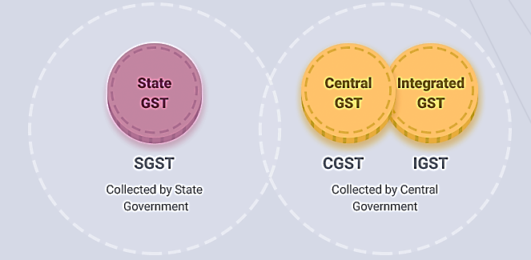
Goods and Services Tax (GST)
GST came into effect in India from 1st July 2017, through the implementation of 101th i.e. One Hundred and First Amendment of Constitution of India. The GST replaced then existing multiple taxes levied by the State and Central Government. It is a comprehensive, multistage, destination-based tax.
Notes:
comprehensive because it has subsumed almost all the indirect taxes except a few state taxes. Multi-staged as it is, the GST is imposed at every step in the production process, but is meant to be refunded to all parties in the various stages of production other than the final consumer and as a destination-based tax, it is collected from point of consumption and not point of origin like previous taxes.

Slide 3
GST (Continued)
GST is Destination based consumption tax (and not origin based tax);
No state and center and concurrent list, common list for both;
It would be a dual GST where center and states will levy it ,,,,,,
Taxes levied by center will be known as CGST;
Taxes levied by State will be known as SGST;
Taxes Levied by Union Territory will be known by UTGST;
Taxes levied on interstate sales and services will be known IGST;
In case of Intra state sales and services (supply) the tax will be charged at one common rate which will be shared equally by center and state (CGST and SGST or CGST and UTGST);
In case of Inter-state sales and services (supply), single rate tax will be charged, known as IGST, which will be collected by center and later on will be passed on to concerned states;

Slide 4
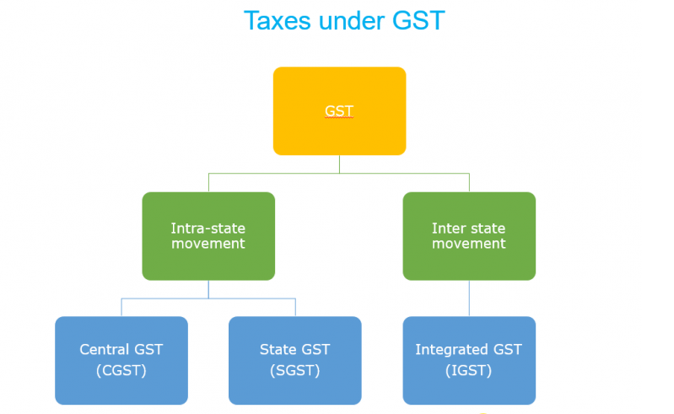

Slide 5
GST Process
GST Portal : https://gst.gov.in
Registration
Invoicing
Return filing
Invoice Matching
Input Tax Credit(ITC)

Slide 6
GST - Registration
In the GST Regime, businesses whose turnover exceeds Rs. 40 lakhs* (Rs 10 lakhs for North East and hill states) is required to register as a normal taxable person. This process of registration is called GST registration.
GST registration usually takes between 2-6 working days.
GST is registered for each state
GSTIN is a 15 characters alphanumeric.
1-2 ( State Code)
3-12 ( PAN Number)
13-15 ( Unique ID number)

Slide 7
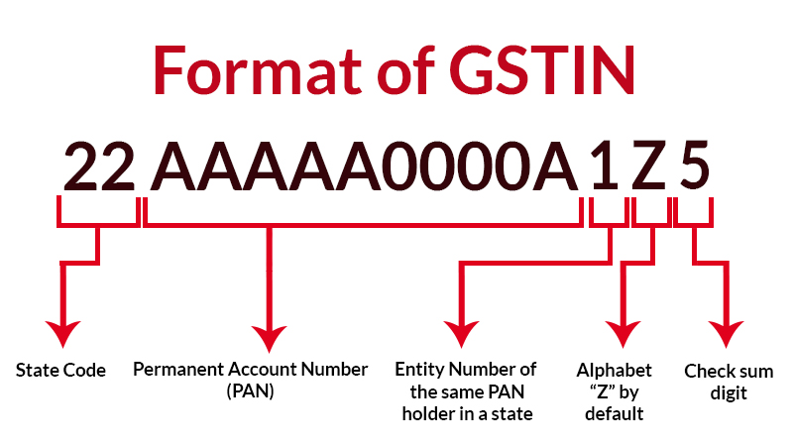

Slide 8
GST – Registration Types
Normal Taxpayer (Regular)
Composition
Casual Taxable Person
Input Service Distributor (ISD)
Non-Resident Taxable Person
Non-Resident Online Service Distributor
Embassy/UN Body/ Other Notified Persons
Special Economic Zone (SEZ) Developer/ Unit
Tax Deductor at Source (TDS) /Tax Collector at Source (TCS)

Slide 9
GST – Registration Types
Normal Taxpayer (Regular) :
Can issue tax invoice
Can avail input tax credit of GST Paid on purchase of goods or services or both.
Has to file returns monthly (GSTR1, GSTR3B)
Composition: This scheme can be opted by any taxpayer whose turnover is less than Rs. 1.5 crore. The following are the advantages of registering under composition scheme:
Lesser compliance (returns, maintaining books of record, issuance of invoices)
Limited tax liability
High liquidity as taxes are at a lower rate
https://gstportalindia.in/types-of-gst-registration-for-indian-taxpayer/

Slide 10
HSN Code/ SAC Code
Goods are classified under HSN Code. HSN full form is Harmonized System of Nomenclature
Services are classified under SAC Code. SAC full form is Services Accounting Code
Based on the HSN or SAC code, GST rates have been fixed in five slabs, namely NIL, 5%, 12%, 18% and 28%.

Slide 11
Tax Invoices
To be issued by the supplier containing, inter-alia, the following details:-
(a) name, address and GSTIN of the supplier/recipient;
(b) a consecutive serial number, unique for a financial year, date of its issue;
(c) Description, Quantity, HSN code of goods or Accounting Code of services;
(d) total value of goods or services;
(e) taxable value of goods or services after discount or abatement, if any;
(f) rate of tax (CGST, SGST or IGST);
(g) amount of tax charged (CGST, SGST or IGST);
(h) place of supply along with the name of State, in case of a supply in the course of inter-State trade or commerce;
(i) place of delivery where the same is different from the place of supply

Slide 12
GST INVOICE IN TALLY

Slide 13
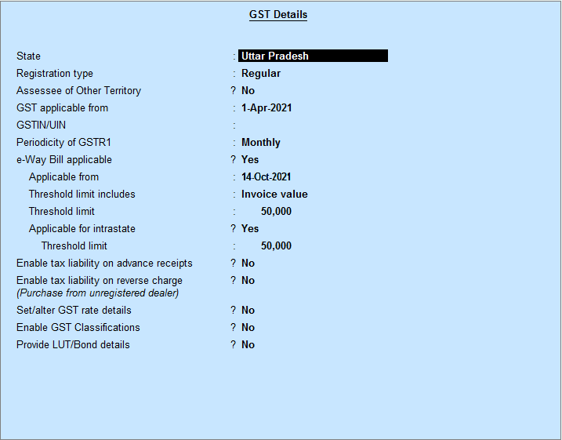
Enable GST in Company
Company Features
Statutory Features
Enable GST
Set/Alter GST

Slide 14
Set GST Rates
GST rate can be set at following levels:
Company Level
Sales/Purchase Ledger Level
Stock Group Level
Stock Item Level
In this practice, the GST will be set at Stock Item Level

Slide 15
Set GST Ledgers
To account for the different taxes to be paid under GST (central tax, state tax, union territory tax, integrated tax, and cess), you have to create a tax ledger for each tax type.
i. SGST [ State Tax at the time of Sale/Purchase Locally ]
ii. CGST [ Central Tax at the time of Sale/Purchase Locally ]
iii. IGST [ Integrated Tax at the time of Sale/Purchase from Outside State ]
Also, sales and Purchase Ledger be modified for enabling GST or ledger should be created with GST enabled.

Slide 16
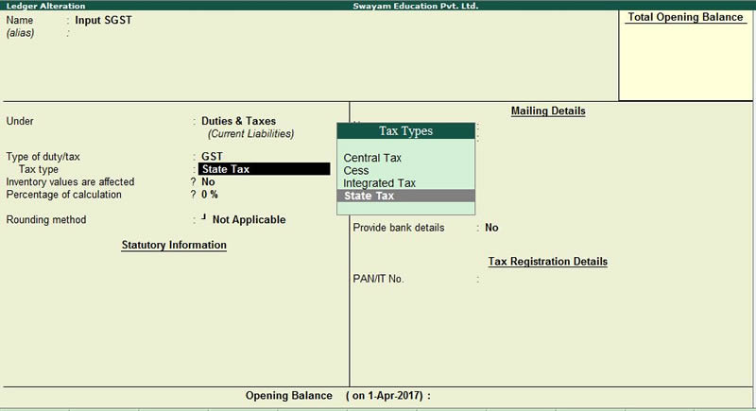
Set GST Ledgers

Slide 17
GST INVOICE
Sample Practice..

Slide 18
GST RETURNS

Slide 19
Need for Returns
Mode for transfer of information to tax administration
To declare tax liability for a given period
Furnish details about the taxes paid in accordance with that return
Compliance verification program of tax administration
Providing necessary inputs for taking policy decision
Management of audit and anti-evasion programs of tax administration

Slide 20
Types Of Returns
Format | Description | Due date
GSTR-1 | Statement of Outward Supplies | 10th of next month
GSTR-1A | Details of outward supplies as added, corrected or deleted by the recipient | Auto-Generated by System
GSTR-2 | Statement of Inward Supplies claiming ITC | 10th to 15th of next month
GSTR-2A | Details of inward supplies made available to the recipient on the basis of GSTR-1 furnished by the supplier | Auto-Generated by System
GSTR-3 | Monthly Return | 20th of next month

Slide 21
Format | Description | Due date
GSTR-4 | Quarterly Returns for Compounding suppliers | 18th of month in next quarter
GSTR-5 | Return for Non-resident suppliers | 20th of next month
GSTR-6 | Return for ISD | 13th of next month
GSTR-7 | Return for TDS Deductors | 10th of next month
GSTR-8 | Details of supplies effected through e-commerce operator and the amount of tax collected | 10th of next month
GSTR-9 | Annual Return | 31st December
GSTR-10 | Final return | Within 3 months of cancellation of Registration
GSTR-11 | Details of inward supplies to be furnished by a person having UIN | 28th of next month

Slide 22
GSTR-1 (Information)
Basic details – GSTIN, Name, period, Turnover in last financial year–mostly auto-populated
Invoice level details
B2B supplies, interstate and intrastate, interstate B2C supplies more than Rs. 2.5 lakh
GSTIN of recipient
Invoice details – Number, date, Value, HSN, Taxable value,
Tax – IGST, CGST, SGST – Rate and Tax amount
Place of Supply
Reverse Charge
Details of supplies where no invoices raised
Advances received; Free Supply
Credit and Debit Notes – linkage to original invoice
Document number
Original Invoice Number
Differential amount and differential tax
(relevant for interstate supplies)

Slide 23
GSTR-1A
Details of exports – with and without payment of tax
Invoice details, Shipping Bill/Bill of Export, tax details
Details of exempt, Nil rated and Non-GST supplies
Interstate and Intrastate B2B and B2C supplies
Amendment of any of the above details filed in previous months
Details of outward supplies as added, corrected or deleted by the recipient
Auto Generated/populated

Slide 24
GSTR-2
Statement of Inwards Supplies
Auto-populated from Statements of outward supplies
Claimed – non auto-populated
Supplies attracting reverse charge
Invoice level details
As in statement of outward supplies
Input Tax Credit available, eligibility and availed
Import of Services
Invoice details, IGST rate and amount, ITC
Details of credit and debit notes
Auto-populated from statement of outward supplies
Claimed – non auto-populated
ISD Credit received
TDS Credit received
Other details of inward supplies
From exempt/composition suppliers
Exempt, nil rated and non-GST supplies

Slide 25
GSTR 2A
Details of inward supplies made available to the recipient on the basis of FORM GSTR-1 furnished by the supplier

Slide 26
Returns Monthly/ Quarterly
Auto-populated based on GSTR-1 and GSTR-2
Outward Supplies
B2B and B2C inter and intra state supplies
Exports
Revision of tax of previous periods
Inward Supplies
Inter and intra state supplies received
Imports
Amendment to tax of previous periods
Credit to ITC Ledger
Tax Liability
Tax on outward supplies
Changes in output liability of previous periods
Amount payable due to reversal of ITC
Payment details
Utilization of credit of each tax (debit to ITC ledger)
Cash (debit to cash ledger)
Claim of Refund of ITC or cash ledger

Slide 27
Annual Returns
Annual summary of all transactions
Accounts to be certified by Chartered Accountant etc. if turnover more than Rs. 2 Crore
Personal Details
Details of Expenditure
Purchases – goods/services – intra/inter state
Imports
Details of Income
Supplies – goods/services – intra/inter state
Exports
Account of taxes payable and paid
Arrears of taxes
Refunds
Profit and Loss
Reconciliation Statement
Not to be filed by ISD, TDS Deductor, Casual Taxpayer, and Non resident taxpayer

Slide 28
Return for Composition Suppliers
No ITC Available
Details of inward supplies
Invoice level – auto-populated and uploaded
Details attracting reverse charge – purchases from unregistered suppliers
Details of import of goods and services
Details of outward supplies – gross basis
Tax liability and payment details

Slide 29
ITC Matching and Reversal
All returns filed with payment of taxes are treated as valid return
Self assessment – ITC to be allowed on filing of return
Provisionally allowed for payment of taxes in that return as per his claim
After filing of return
ITC claims checked for duplication
ITC claims matched with tax paid in valid returns
Claims that come as a result of auto-population taken as matched if tax paid by supplier
Uploaded invoices matched with supply invoices
Duplicate claims communicated to recipient and unmatched claims communicated to both
ITC claimed on duplicate invoice added in next return
Unmatched invoices
Either supplier owns up in next return and uploads it as part of his next month’s GSTR-1 – match in that return cycle
Otherwise, ITC claim remains unmatched in next month return and gets added in next return

Slide 30
Correction in Returns
No Revision of returns
As per the return taxes have already been paid and fund transfers already settled
No significance as the basis now is individual transaction
All changes through amendments in subsequent returns
If an invoice has been left out in GSTR-1 or GSTR-2 – can be uploaded in subsequent returns
If and invoice has been wrongly entered but remains unmatched – can be amended in subsequent returns;
Post transaction changes to be done through debit or credit notes
Other details like B2C supplies can be amended in subsequent returns
Delayed uploading coupled with payment of interest
All changes, credit or debit notes to be carried out before September of the next financial year
To enable any auto-reversal before Annual Return

Slide 31
ITC Matching and Reversal
All returns filed with payment of taxes are treated as valid return
Self assessment – ITC to be allowed on filing of return
Provisionally allowed for payment of taxes in that return as per his claim
After filing of return
ITC claims checked for duplication
ITC claims matched with tax paid in valid returns
Claims that come as a result of auto-population taken as matched if tax paid by supplier
Uploaded invoices matched with supply invoices
Duplicate claims communicated to recipient and unmatched claims communicated to both
ITC claimed on duplicate invoice added in next return
Unmatched invoices
Either supplier owns up in next return and uploads it as part of his next month’s GSTR-1 – match in that return cycle
Otherwise, ITC claim remains unmatched in next month return and gets added in next return

Slide 32
Accounts and Registers
Electronic Tax Liability Register FORM GST PMT-1 on the Common Portal
It shall be debited by:
(a) the amount payable towards tax, interest, late fee or any other amount payable as per the return;
(b) the amount of tax, interest, penalty or any other amount payable as determined by a proper officer.
It shall be Credited by:
Payment of every liability as per return shall be made by debiting the electronic credit ledger or the electronic cash ledger and the Tax Liability register shall be credited accordingly.
The amount of penalty imposed shall stand reduced partly or fully, as the case may be, if the taxable person makes the payment of tax, interest and penalty specified in the show cause notice or demand order, and the Tax Liability register shall be credited accordingly.

Slide 33
Credit Ledger
Electronic Credit Ledger shall be maintained in FORM GST PMT-2 on the Common Portal
It shall be credited by
Every claim of input tax credit under the Act shall be credited to the said Ledger.
It shall be debited by
The extent of discharge of any liability,
Claim of refund of any unutilized amount from the electronic credit ledger.
If the refund so filed is rejected, either fully or partly, the amount debited, to the extent of rejection, shall be re-credited to the electronic credit ledger by the proper officer by an order made in FORM GST PMT-2A.

Slide 34
Cash Ledger
The electronic cash ledger in FORM GST PMT-3 on the Common Portal
Credited for the amount deposited
And debited for the payment there from towards tax, interest, penalty, fee or any other amount.

Slide 35
Invoice Matching
Invoice matching is a concept wherein all the taxable supplies procured by a buyer and supplied by a seller are matched. The Government, through this concept, seeks to ensure the accurate transfer of Input Tax Credit (ITC) between the states and the parties in a transaction.
The procurer of goods is eligible to claim Input Tax Credit (ITC) for specified transactions. This benefit can only be claimed when the details of inward supply filled by the purchaser in GSTR-2 matches with the details of outward supply filled by the supplier in GSTR-1. Hence the need for this mechanism.
Invoice matching is a mechanism wherein all taxable GST supplies are matched with the ones received by the purchaser.
Components to be Matched
The following details must be matched in the GSTN portal while filing Form GST-2:
GSTN of the supplier
GSTN of the recipient
Invoice/Debit Note number
Invoice/Debit Note date
Taxable value
Tax amount

Slide 36
SISOFT TECHNOLOGIES Pvt. Ltd.

Slide 37
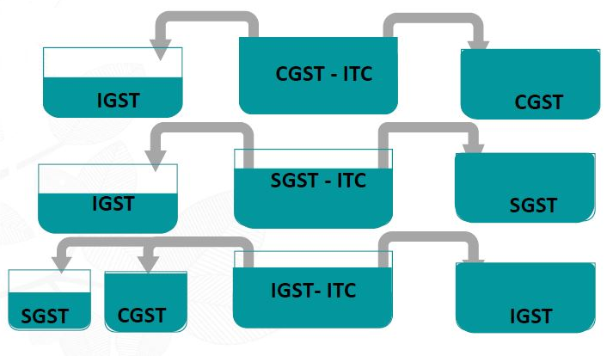
ITC OFFSET

Slide 38
Return for Non-resident Tax Payers
Backed by advance tax
They can take credit of IGST on import and pass on credit on all supplies
Credit of tax paid on imports
Details of outward supplies
Similar to GSTR-1
Details of tax paid
– ITC ledger and cash ledger
Closing stock of goods

Slide 39
Return for ISD
Details of inward supplies
Similar to GSTR-2
Details of credit distributed
GSTIN of recipient
Invoice details
Credit distributed – IGST, CGST, SGST
ITC account
ITC received
ITC distributed

Slide 40
Return for TDS Deductors
Pertains to cash ledger and not credit ledger
TDS details
GSTIN of deductee
Invoice details – number, date value
TDS details – rate and amount – IGST, CGST, SGST
Details of payment – only by cash ledger
TDS amount cannot be paid by debiting ITC ledger`

